Slide 1
Lists: indexing and slicing.
Week 4 | Lecture 3 (4.3.1)

Slide 2
Today’s Content
Lecture 4.3.1
Lists: indexing and slicing
Lecture 4.3.2
Lists: nested lists and looping
Next Week
Design Problems!
Midterm Review

Slide 3

Midterm: 1 Week Today!

Slide 4

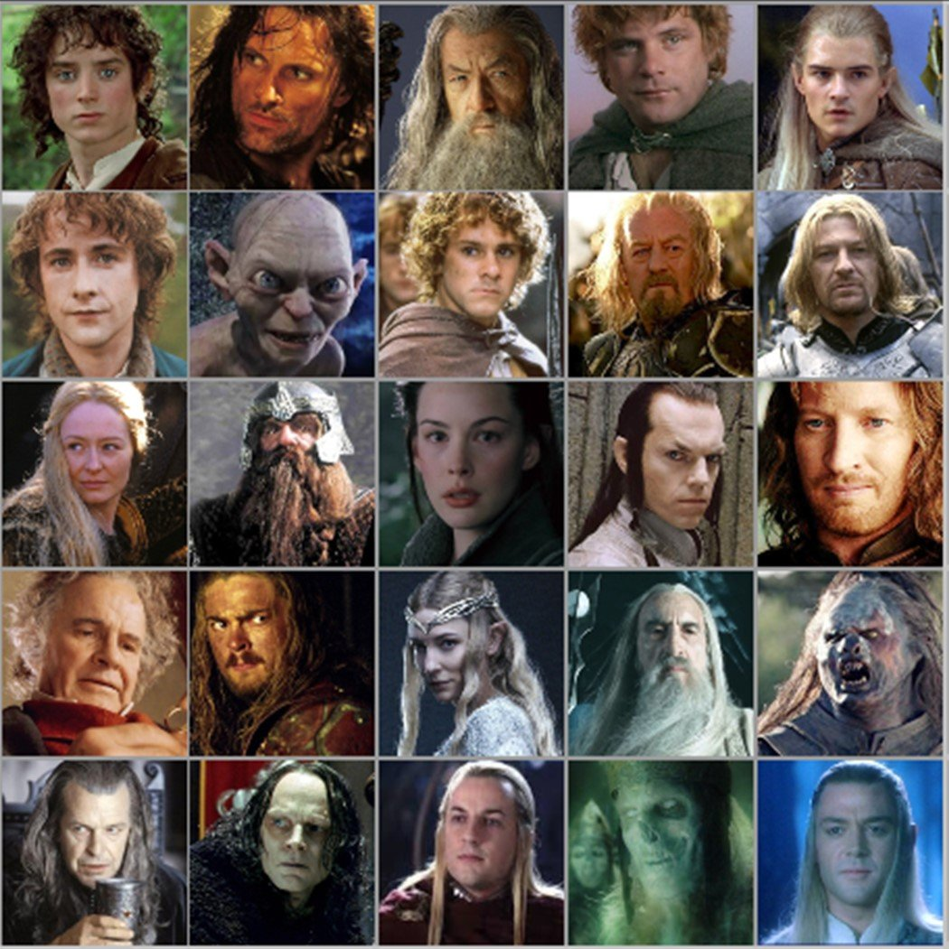


Motivation
We want to keep track of characters in a complex show/book
Name
Actor
Personality
Age
Title/Powers
We could store values in a string?
We could have unique variable names for each person?
gandalf_age = 24000
frodo = ”Frodo-Elijah Wood-brave, observant, and unfailingly polite-51-Ring bearer"
We need an efficient way to do this.

Slide 5
One way: Tables or Lists!
Name | Gender | Actor | Personality | Age | Powers
Sam | M
Frodo | M
Gandalf | M
Galadriel | F
Pippin | M
Aragorn | M
Legolas | M
Eowyn | F
Gollum | M
Arwen | F
Merry | M
Need to:
Create rows of data
Create columns of data
Be able to access a specific cell/index

Slide 6
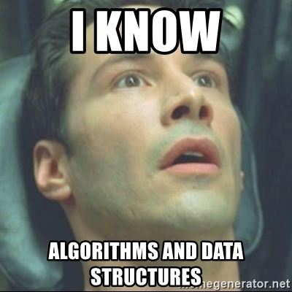
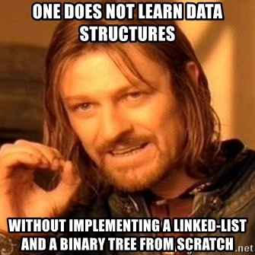
Data Structures!
Data structures are “containers” that organize and group data
Lists
Sets
Tuples
Dictionaries
Linked lists
Binary trees

Slide 7

Type: List
Can store an ordered collection of data using Python’s type list
The general form of a list is:
Values are enclosed in ([ ]) and separated by commas (,)
Can assign lists to a variable name:
[val1, val2, val3, …, valN]
my_list = [val1, val2, val3, …, valN]

Slide 8
List Elements
list elements can be of any type:
A list can contain elements of more than one type:
subjects = [‘bio’, ‘programming’, ‘math’, ‘history’]
grades = [75, 98, 82, 62]
street_address = [10, ‘Main Street’]
light = [‘status’, True, ‘intensity’, 3.1]

Slide 9
List Operations (Indexing and Slicing)
A list can be indexed just like a string:
A list can be sliced just like a string:
>>> grades = [80, 90, 70, 45, 98, 57]
>>> grades[1]
90
>>> grades[-3]
45
>>> grades[0:2] [80, 90]
>>> grades[::-2] [57, 45, 90]

Slide 10

Nested Lists
Lists can contain any type, including other lists!
Called “nested lists”
To access a nested item, first select the sublist, then treat as a regular list
[list1, list2, …, listN]
[val1, val2, …, valN]
>>> list_of_lists[0]
[val1, val2, …, valN]
>>> list_of_lists[0][1]
val2

Slide 11
Nested Lists Example
Let’s provide some information in our list of grades:
Now we can access different parts depending on what we want:
>>> aps106_grades = [[‘Midterm 1’, 60],[‘Midterm 2’, 90],[‘Exam’, 100]]
>>> aps106_grades = [[‘Midterm 1’, 60],
[‘Midterm 2’, 90],
[‘Exam’, 100]]
BOTH OF THESE ARE THE SAME THING!
>>> aps106_grades[0]
[‘Midterm 1’, 60]
>>> aps106_grades[2][1]
100

Slide 12
Let’s Code!
Let’s take a look at how this works in Python!
Creating lists
List indexing and slicing
List operations
Nested lists!
Open your notebook
Click Link:
1. The ‘list’ Type

Slide 13
List Mutability
Lists are mutable!
This means they can be mutated (modified)
All the other types we’ve learned so far (string, int, float, and bool) are immutable (i.e. they can NOT be modified)

Slide 14
List Mutability Example
>>> s = “I love cats”
s[0] = “U”
Traceback (most recent call last):
builtins.TypeError: 'str' object does not support item assignment
>>> grades = [80, 90, 70, 45, 98, 57]
>>> grades[3] = 100
>>> grades[-1] = 100
>>> grades[2] = ‘Perfect’
>>> grades
[80, 90, ‘Perfect’, 100, 98, 100]
strings are immutable
lists are mutable

Slide 15
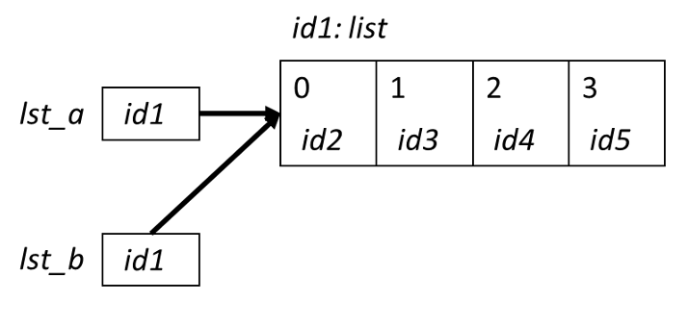

Aliasing
When two variable names refer to the same object, they are aliases.
When we modify one variable, we are modifying the object it refers to, hence also modifying the second variable.
This is common source of error when working with list objects.

Slide 16
Aliasing Example (with Visualizer)
Permalink:
https://tinyurl.com/aps106alias

Slide 17
Avoiding Aliasing
>>> lst1 = [11, 12, 13, 14, 15, 16, 27]
>>> lst2 = lst1
>>> lst1[-1] = 17
>>> lst2
[11, 12, 13, 14, 15, 16, 17]
>>> id(lst1)
49012568
>>> id(lst2)
49012568
How can we copy lst1 into another list without aliasing?

Slide 18
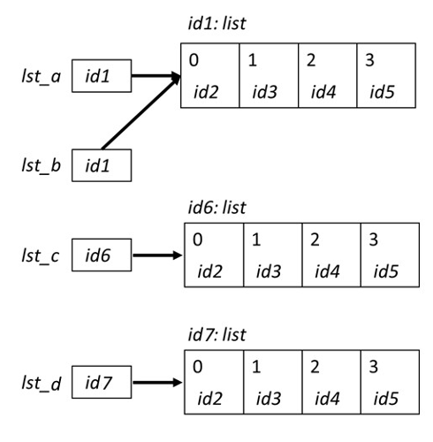
Copying Lists and Avoiding Aliasing
There are two simple ways to copy lists:
Using the list( ) function
Completely slice the list [:]
>>> lst_a = [0, 1, 2, 3]
>>> lst_b = lst_a
>>> lst_c = list(lst_a)
>>> lst_d = lst_a[:]
>>> id(lst_a)
39012510
>>> id(lst_b)
39012510
>>> id(lst_c)
54514112
>>> id(lst_d)
24514139

Slide 19
Avoiding Aliasing Example (with Visualizer)
Permalink:
https://tinyurl.com/aps106alias2

Slide 20
Let’s Code!
Let’s take a look at how this works in Python!
List mutability
Aliasing
Copying lists
Open your notebook
Click Link:
2. Mutability and Aliasing

Slide 21
Built-in Functions
Several of Python's built-in functions can be applied to lists, including:
len(list) : return the number of elements in list (i.e. the length)
min(list) : return the value of the smallest element in list.
max(list) : return the value of the largest element in list.
sum(list) : return the sum of elements of list (list items must be numeric).

Slide 22
List Methods
Lists are objects and just like other objects, the list type has associated methods that are only valid for lists
Recall you can find out which methods are associated with objects using the built-in function dir
>>> dir(list)
['__add__', '__class__', '__class_getitem__', '__contains__', '__delattr__', '__delitem__', '__dir__', '__doc__', '__eq__', '__format__', '__ge__', '__getattribute__', '__getitem__', '__gt__', '__hash__', '__iadd__', '__imul__', '__init__', '__init_subclass__', '__iter__', '__le__', '__len__', '__lt__', '__mul__', '__ne__', '__new__', '__reduce__', '__reduce_ex__', '__repr__', '__reversed__', '__rmul__', '__setattr__', '__setitem__', '__sizeof__', '__str__', '__subclasshook__', 'append', 'clear', 'copy', 'count', 'extend', 'index', 'insert', 'pop', 'remove', 'reverse', 'sort']

Slide 23
Adding Items to a List
To add an object to the end of a list, use the list method append:
To add a list to the end of a list, use the list method extend:
>>> colours = ['blue', 'yellow’] >>> colours.append('brown’) >>> colours ['blue', 'yellow', 'brown']
>>> colours = ['blue', 'yellow’] >>> colours.extend([‘pink’,‘green’]) >>> colours ['blue', 'yellow', ‘pink’, ‘green’]

Slide 24
Removing Items from a List
To remove an object from a list, use the list method remove:
How can we write it so there’s no error?
>>> colours = ['blue', 'yellow’, ‘pink’] >>> colours.remove(‘yellow’) >>> colours ['blue', ‘pink’]
>>> colours.remove(‘red’)
Traceback (most recent call last):
builtins.ValueError: list.remove(x): x not in list

Slide 25
Is something in my list?
The in operator can be used on lists too!
colours = ['blue', 'yellow’, ‘pink’]
if ‘red’ in colours:
colours.remove(‘red’)

Slide 26
Let’s Code!
Let’s take a look at how this works in Python!
Open your notebook
Click Link:
3. List Methods

Slide 27
Lists: indexing and slicing.
Week 4 | Lecture 3 (4.3.1)

